Slide 1
2026 Community Mental Health Survey
Trust webinar
12th March 2026

Slide 2
Contents - Agenda
Survey overview (5 minutes)
Key areas for discussion (70 minutes):
Engagement & publicising the survey (40 minutes)
Mental Health Currency Model (10 minutes)
Primary care – Integrated community models of care (5 minutes)
Community Treatment Orders (CTOs) (5 minutes)
Transition from CYPMHS to AHMS (5 minutes)
Boosted samples (5 minutes)
Key dates (5 minutes)
Questions (10 minutes)

Slide 3

Survey Overview

Slide 4
Overview of Community Mental Health Survey
Run annually
Participation
Survey has run almost
every year since 2004
50 Community Mental Health Trusts (CMHT) participate
Mixed mode
Sample
Survey can be completed online, paper (postal), telephone
Service users who attended CMHT during April and May 2026
Accessibility
Eligibility
Survey available in Large Print, Braille, Easy Read, 10 different languages, and BSL. Can also call interpreter for help in 22 languages
Must be at least 16 years old to participate and had two contacts, one during sampling period and another during, before or after

Slide 5
Survey timeline
February – April 2026: Stakeholder feedback & questionnaire amends
July 2026: Trust draw samples of service users
Spring 2027: Analysis results of survey responses
Development
Testing
Sampling
Fieldwork
Analysis
Publication
May – June 2026: Test amended questionnaire with service users
August – November 2026: Contractors and in-house trusts send out mailings and collect responses
Spring 2027: Results published

Slide 6
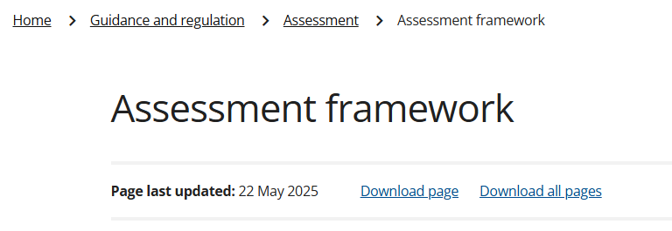
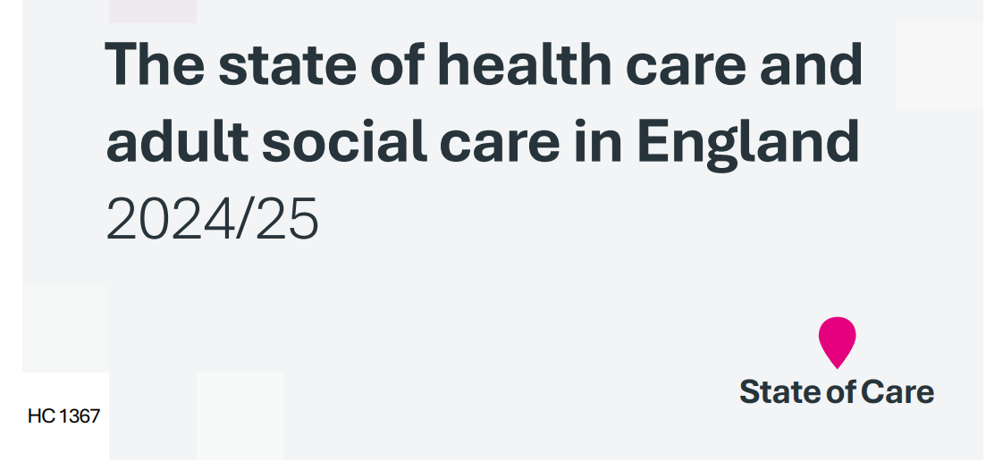


Community Mental Health Survey: performance monitoring and evaluation
Trust level data analysis and reporting
Used by individual NHS trusts and Integrated Care Systems (ICS) to:
Incorporate service user experience into decision-making
Identify areas they are performing well and areas for improvement
Monitor progress over time
Support education and training for staff
The Care Quality Commission (CQC) and NHS England (NHSE) use the results to assess NHS performance and for use within inspections
This includes highlighting where there are safety concerns or examples of good care:
CQC’s Assessment Framework
The State of Health Care and Adult Social Care in England
Community Mental Health Survey 2024: National qualitative report

Slide 7

Publication of 2025 Results
Pre-publication results: redacted benchmark reports
Publication of all results
^{Mid - March}
^{31st March}
*Due to national statistic restrictions, we cannot discuss findings until publication date*

Slide 8

Engagement & publicising the survey

Slide 9
Response rates 2004 - 2024
Survey response rates have declined year on year
In 2024, the response rate was 20%

Slide 10




Publicising the survey: why is it important?
Encourages service users to participate
Increased representation within the data
Provides service users with a voice and opportunities to share their feedback with trusts
Helps to maintain / increase response rate
Increases cases for analysis
Further analysis of questions at trust level and by Assessment Service Group (ASG)
Sub-group analysis
Reduces the possibility of suppression
For further information:
https://nhssurveys.org/survey-instructions/publicising-surveys/

Slide 11


Publicising the survey: methods for publicising
2025:
Press Release Template
Four Social media cards
Website banner
Dissent poster / leaflet
16-17 year olds leaflet
Infographic: 2024 results
Changes for 2026:
Explore the redesign of the materials to make them more motivational and engaging
Social media cards schedule: re-publication of cards to boost exposure

Slide 12

Dissent poster
Purpose:
Makes sure service users are aware of the survey
Provides an opportunity for them to ask questions or opt out
Requirement for CAG approval – confirmation that patient notification steps have been undertaken
New design in 2024 following trust feedback to follow neurodivergent design principles. This design will be kept for 2026
Poster available in the following languages: Kurdish Sorani, Portuguese, Italian, Polish, Romanian, Arabic, Bengali, Gujarati, Indian Punjabi, Spanish, Ukrainian and Urdu
How to use it:
Display printed copy on noticeboards
Display digital versions on TV screens
Questions:
Where should the poster be displayed so that as many service users as possible see it?
Do you require the poster in any other languages?
Any feedback on the dissent poster format or ease of use?

Slide 13


16-17 year olds leaflet
The leaflet:
Provides an opportunity for all 16-and-17 year olds who are receiving community mental health care to ask questions or opt out
Was redesigned in 2024 following trust feedback
How to use it:
Needs to be provided to all 16-and-17 year olds who use community mental health services in your trust – CAG requirement
Questions:
How do you share this leaflet with 16 and 17 year olds?
How do service users/young people find the format?
Do 16 and 17 year olds find it useful? Does it encourage them to participate?
Any other feedback on the leaflet?

Slide 14
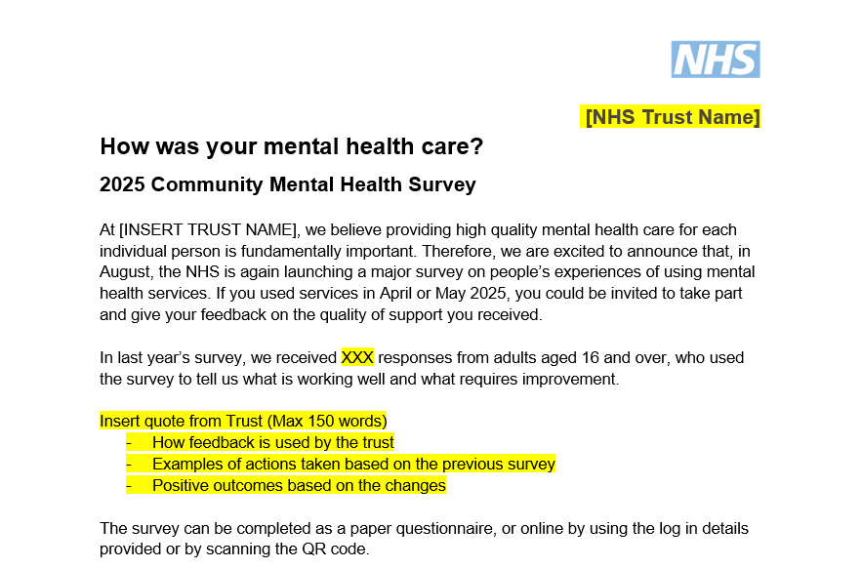

Press release template
The template explains:
Purpose and value of participation
What happens to feedback – knowing that something happens with results is important to respondents
Information on how to participate
Placeholder for trusts
How to use it:
Publish in your regular newsletters
Upload to your trust’s ‘news’ page
Poll: Did you use the Press release template provided last year?
Questions:
How do you share the press release?
What would make it easier for you to use?
Are the tone and messages clear and fit for your population?

Slide 15



Website banner
How to use:
Poll 1: Did your trust use the website banner to publicise the survey last year?
Across all your social media platforms
Add to your trust’s website
Include in service user materials (e.g. e-bulletins)
Poll 2: How was the website banner used at your trust?
Questions:
Are there any restrictions regarding the design that we should be aware of?

Slide 16


Social media card 1: Pre-fieldwork
This will be provided in early April before fieldwork to build awareness of the survey amongst service users.
How to use:
Share with service users who could be included in the sample
Share across all your social media platforms and other appropriate channels
Print and share as handout to service users when they attend appointments
Add to waiting room TV screens
Social media card 1: Publish in April. Re-share throughout May – July.

Slide 17



Social media cards 2, 3 & 4: Raising awareness
How to use:
Share across all your social media platforms and any channels appropriate for patient engagement
Ask your comms team to pin on their social media until the next reminder is published / until the end of fieldwork
Re-share until the next social media card is published
Print and share as handout to service users during appointments
Social media card 2: Publish in early August. Reshare late August – early September.
Social media card 3: Publish in mid-September. Research mid-October.
Social media card 4: Publish in early November. Re-share in mid-November.

Slide 18
Social media cards: Questions
Poll 2: How were the social media cards shared?
Poll 1: Did your trust use the social media cards to promote the 2025 survey?
Question:
Why did you choose those platforms?
Are there any apps or websites that service users regularly use that the survey could be promoted on?
Is there anyone else in your organisation we should contact / share the social media cards with?
Question:
If no, why didn’t you use them?

Slide 19
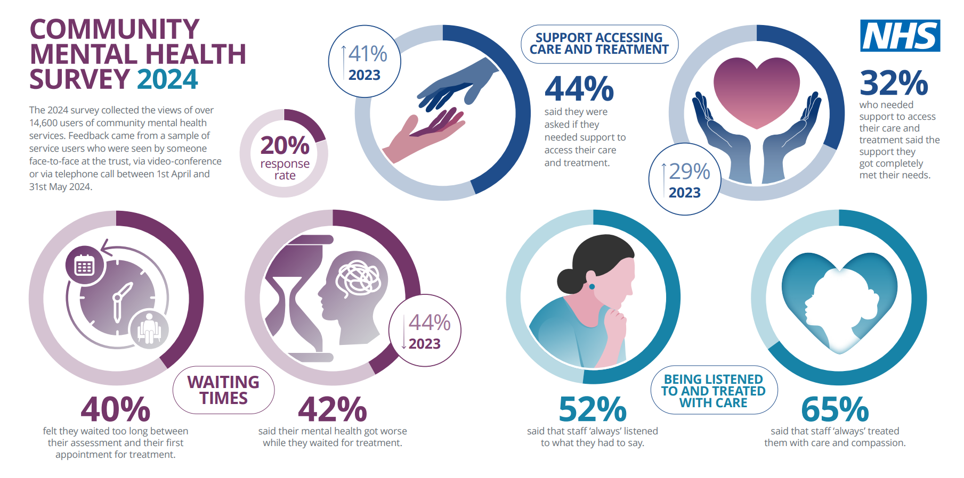
Infographic
The infographic:
Emphasises the importance of the survey findings
Lets service users know that their voices have been heard
How to use it:
Share with service users via trust website social media channels, newsletters, email communications
Print off copies to display on site
Questions:
If you used it, how did you use it?
If you didn’t use it, why not?
Is it useful?
Poll: Did you use the infographic to promote the 2025 survey?

Slide 20
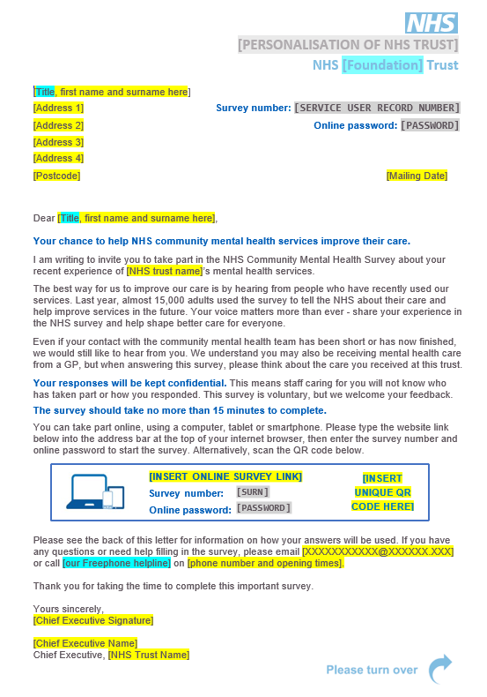
Boosting engagement: Mailing letter updates
To try and increase response rates, we will explore ways to update the mailing letters to make them more engaging and motivating.
We have been asking service users and stakeholders during our consultation phase about how we can improve the letters.
Questions:
How do you engage with service users?
What information do you think the survey letter should contain?
Is the tone appropriate for service users?
What should it look like?
What do you think about the length?

Slide 21
Engagement & publicising the survey: discussion
How can we support you in publicising the survey?
Are there any other materials you would find useful? Any other formats? (e.g. Email banners)
What information is important for this population? Is there any key information used to encourage engagement from this population?
How can we better reach this population?
Is there anything we’re presenting that won’t work for this group?
Is there anything we could do differently?

Slide 22

Availability of mobile phone numbers
Having mobile phone numbers for service users means we can send out SMS information about the survey, including a direct link to complete it.
This is really important for the whole sample, and particularly to reach younger service users.
Low proportions of mobile phone numbers available can be linked to a reduced response rate. We would like to understand why there are low proportions of mobile phone numbers available.
Questions:
Do you use mobile numbers to contact service users?
If so, what do you use them for? E.g., confirming appointments, surveys etc.
How frequently do you use this contact method? E.g. for appointments only, or for comms/updates about services.
Are there any reasons why you might have low proportions of mobile numbers for service users?
Do you routinely collect a mobile number for service users?
How often are mobile phone numbers verified/updated?
What are the known challenges with collecting mobile phone numbers?
Do you see a difference in coverage of mobile phone numbers for different service users, or service teams?
How can the availability of mobile phone numbers be improved?

Slide 23

Mental Health Currency Model

Slide 24
Mental Health Currency Model
NHS England has released details of a new mental health currency
The new model replaces the former currency (21 clusters) for adult mental health pathways
The new currency groups mental health activity into units known as mental health and neurodevelopmental resource groups (MHNRGs)
Psychosis and bipolar disorders;
Personality disorders;
Neurocognitive disorders;
Mood and anxiety disorders;
Eating and feeding disorders;
Children and young people
Service users are then further grouped into one of three settings: community, inpatient or crisis

Slide 25
Mental Health Currency Model
Questions:
Has the new model been fully implemented at trust level?
How is the data captured in patient record systems?
Could this data be added to your sample?
Could one sample variable to capture the resource groups?
Could another sample variable to capture the setting (e.g. community; inpatient; crisis)?
Does the new model capture severity of condition?
If it does, could we add severity to the survey sample?
If it doesn’t, what data can be added to the sample to record severity of service users’ condition?

Slide 26
Primary care – Integrated community models of care

Slide 27
Primary care – Integrated community models of care
CMH collects feedback from service users on their experience with the team at their CMH trust.
However, we are aware of the creation of local Community Mental Health Hubs – Community trusts are working together with GPs, Mental health practitioners embedded in primary care, Social workers, Peer support workers, Psychologists and Voluntary and community sector (VCS) partners to deliver care based on the needs of the population.
We would like to understand how these services are working together and how we can continue to ensure service users are only responding in relation to the care they received from the community mental health team.
Questions:
Are community mental health trusts interacting and working more closely with primary care services now compared to previous years?
Are there areas of services where integration is working better or worse?
As primary and community services further develop integrated care, what would you want to see from this survey?
How can we ensure that the survey feedback clearly reflects the community mental health services provided by your trust?

Slide 28

Community Treatment Orders (CTOs)

Slide 29
Community Treatment Orders (CTOs)
Community Treatment Orders (CTOs) provide a framework for supervised treatment, helping individuals with severe mental health conditions being treated in the community, instead of staying in hospital.
We want to try to understand the experiences of service users who have a CTO in place.
We added the following question about CTOs to the 2025 online survey: “In the last 12 months, have you had a Community Treatment Order (CTO) in place?”
By being able to indicate whether a service user has had a CTO in place, we can compare their experience of community mental health services against those who have not been on a CTO.
Questions:
Would this be helpful data for you?
How would you use the survey data?
Can you identify whether a service user has or had a CTO?
Can you identify when the service user was on a CTO? E.g. in the last 12 months?
Is it feasible to add a new sample variable to collect this information?

Slide 30

Transition of service users from CYPMHS to AMHS

Slide 31
Transition from CYPMHS to AMHS
In the 2023 and 2025 survey, we tried to explore transition experience but did not have sufficient responses to report on questions.
We’d like to understand if this continues to be an area of interest.
Questions:
Is understanding how experience of service users who have recently transitioned from Children and Young People’s Mental Health Services (CYPHS) to Adult Mental Health Services (AMHS) of interest to trusts?
We currently ask respondents if they have transitioned in the past 6 months. Could we instead ask about the past 12 months to try and increase the number of responses?
Do you capture data in your patient recording systems, on whether a service user has transitioned from CYPMHS to AMHS?
Could an indicator be added to the sample to note whether they had recently transitioned?
Are there any other places where you record this data e.g. is this survey the best place to try and capture this information?

Slide 32

Boosted samples

Slide 33
Boosted samples
In 2023, 2024 & 2025, Trusts had the option to submit a higher number of service users within their sample.
1,250 was the minimum threshold but trust could choose to boost their sample to a higher number.
Boosting samples helps to receive a higher number of responses. The more responses received, allows for more granular reporting due to increased reliability and confidentiality of results.
Higher numbers may allow us to report by:
Service type / teams
Demographics breakdowns
Question:
What are the current barriers or challenges in boosting your sample?

Slide 34

Key dates

Slide 35
Timeline of activities
Activity | Date
Service user interviews | March 2026
Confirm who your contractor is | April 2025
Share Press Release template | April – July 2026
Section 251 approval | May 2026
Display dissent posters | April – July 2026
Share 16-17 year olds leaflet | April – July 2026
Share Social media card 1 | April – July 2026
Use Website banner | August – November 2026
2nd Trust webinar | June 2026
Trusts to draw samples | July 2026
Share social media cards 2 & 3 | August – November 2026
Fieldwork | 17th August – 27th November 2026
Share social media card 4 | November 2026
Analysis | Spring 2027
Publication | Spring 2027

Slide 36
Questions?

Slide 37
Thank you for your time
If you have any further thoughts or queries, please contact us at:
mentalhealth@surveycoordination.com
Community Mental Health Survey website:
https://nhssurveys.org/surveys/survey/05-community-mental-health/

